Slide 1
Delta Merge

Slide 2
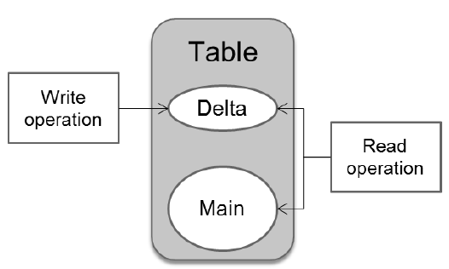
Column Store
A column store table is comprised of two index types, for each column a main index and a delta index.
The delta storage is optimized for write operations and the main storage is optimized in terms of read performance and memory consumption.
The use of the delta tables addresses the performance issues of loading directly to compressed columns.
Read operations are performed on both parts whereas write operations only affect the delta part.
In order to optimize query execution performance of the system and to ensure optimum compression, the system needs to transfer the data from the delta part into the main part. This process is called delta merge.

Slide 3
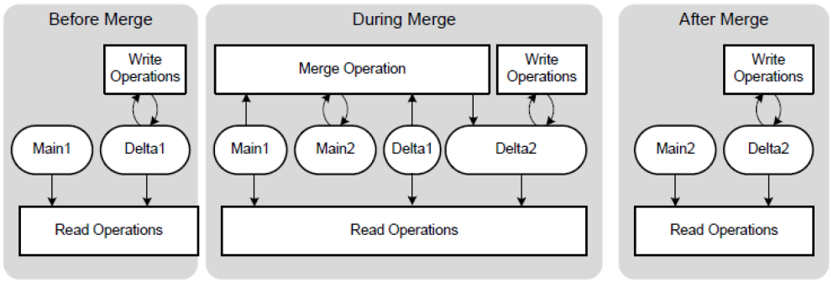
Delta Merge
Before the merge operation:
All write operations go to storage Delta1 and read operations read from storages Main1 and Delta1.
During the merge operation:
While the merge operation is running, all changes go into the second delta storage, Delta2. Read operations read from the original main storage, Main1, and from both delta storages, Delta1 and Delta2. Uncommitted changes in Delta1 are copied to Delta2. The content of Main1 and the committed entries in Delta1 are merged into the new main storage, Main2.
After the merge operation:
After the merge, Main1 and Delta1 storages are deleted.

Slide 4
Merge on Partitioned Tables
Executing a delta merge on partitioned tables can have a positive impact on the memory consumption during merge operation and the performance. Every partition of a table is treated internally as a standalone table with its own main and delta store.
When it comes to executing the delta merge, only the affected partitions of a table will be treated by the merge operation. As described before, the whole table has to be duplicated during the merge. For partitioned tables therefore, the amount of needed main memory during the merge is reduced, depending on the size of the partition.
As the merge duration mainly depends on the size of the merged table in main memory, merging a partition only also affects the merge runtime positively.

Slide 5
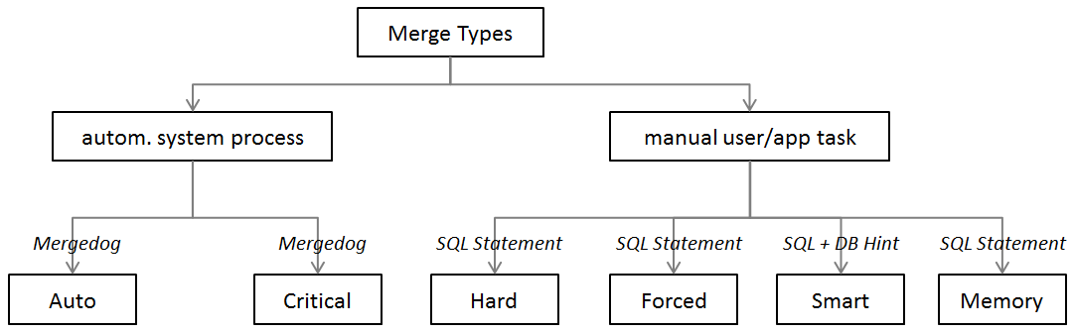
Merge Types
Two categories:
Automatically executed by the system via a process called mergedog
Can be triggered manually, either through an application (e.g. BW) or by a user sending an SQL statement to HANA.

Slide 6
Merge Types – Automated System Process
Auto Merge (default setting)
A system process called “Mergedog” periodically checks the column store tables which are loaded locally to the storage server and for which auto merge is enabled. It then determines for each individual table (or single partition of a split storage) if a merge should be executed based on configurable criteria.
Auto Merge is the default setting and it is recommended not to change the settings for that as this is and will be the SAP optimized way for merging tables in HANA.
You might consider turning OFF Auto Merge when loading large tables and turning it ON again once tables are loaded.
Auto merge is used in SAP NetWeaver BW powered by SAP HANA’s data store object activation process

Slide 7
Merge Types – Automated System Process
Critical Merge
The critical merge aims at keeping the system stable.
In a case where auto merge has been disabled and no manual merge hints are sent to the system, the delta size could grow too large for a successful delta merge.
The critical merge will automatically initiate a delta merge when a certain threshold is passed. This will therefore overrule other merge settings.

Slide 8
Merge Types – Manual Update/App. Task
Smart Merge
If an application requires more direct control over the merge process, SAP HANA supports a function that enables the application to request a delta merge via SQL command.
The HANA system then determines if a delta merge should be executed, by evaluating the delta merge decision function from in indexserver.ini.
For example, if an application loads relatively large data volumes, a delta merge during the load may have a negative impact on the load performance and on other system users. Therefore, the application can disable auto merge for the tables that are being loaded and send a smart merge database “hint” to the database as soon as the load process is complete.
SQL Syntax:
MERGE DELTA OF <table_name> WITH PARAMETERS ('SMART_MERGE'='ON' | ‘OFF’)

Slide 9
Merge Types – Manual Update/App. Task
Smart Merge (Contd.)
As soon as the application, e.g. SAP NetWeaver BW, issues a smart merge “hint” to the database in order to trigger the merge processes, the following occurs:
The system parameters configured for the “smart merge” process are evaluated
If the parameters indicate a merge is required, the merge is executed
If the “smart merge” parameters indicate a merge is not required, there is no further action and only a subsequent new hint from the application will trigger another evaluation of the parameters.
For tables you want to merge with the smart merge you should disable the auto merge. Otherwise it could be that the auto merge and smart merge interfere each other.
Smart merge is particularly relevant to SAP NetWeaver BW developers and administrators since it requires the implementation of SAP NetWeaver BW triggers to initiate the delta merge for certain SAP NetWeaver BW loading processes.

Slide 10
Merge Types – Manual Update/App. Task
The following merge types are not used in SAP NetWeaver BW powered by SAP HANA. They are initiated either manually, using an SQL function, or automatically.
Memory Merge
When issuing a merge via SQL statement, optional parameters can be passed which tell the system to do the merge only in memory.
As a consequence, the changes are not yet written to the persistence layer and the delta log is not truncated. The update of the delta merge to the disk is subsequently processed via merge statement via SQL.
SQL Syntax:
MERGE DELTA OF 'tableName' WITH PARAMETERS ('MEMORY_MERGE' = 'ON' | ‘OFF’)
Hard Merge
A hard merge is issued via a SQL statement and tells the server to execute the delta merge in any case that means without evaluating any formula from the configuration. However, the hard merge takes the token concept into account.
SQL Syntax:
MERGE DELTA OF 'tableName'

Slide 11
Merge Types – Manual Update/App. Task
Forced Merge
Forced merge is similar to a hard merge.
It tells the system that delta storage must be merged disregarding any other factors, like system resource availability, delta storage size, etc.
It may be useful in a situation where there is a heavy system load, but a small table needs to be merged or if a missed merge of a certain table is negatively impacting system performance.
The forced merge statement ignores the token concept
SQL Syntax:
MERGE DELTA OF '<table_name>' WITH PARAMETERS ('FORCED_MERGE' = 'ON'|’OFF’)

Slide 12
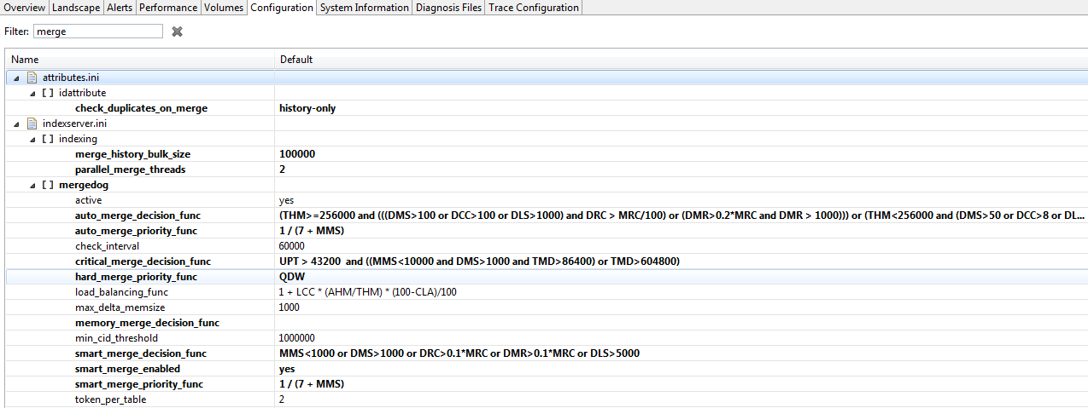
Delta Merge - Configuration
Cost Function
The SAP HANA database will decide whether a requested delta merge should be executed or not, based on a cost function calculated during runtime.
Merge Token Configuration
Delta merge can create a heavy load on system resources. Therefore, controls need to be applied to ensure the delta merge processes do not consume all system resources.
The control mechanism is based on the allocation of tokens to each merge process. With the exception of the forced merge, a merge process cannot start unless it has been allocated tokens.

Slide 13
Parameters to configure the cost function:
Derived From an Actual Table:
DMS delta memory size [MB], is zero MB for an unloaded table
MMS main resident memsize [MB], this is zero MB for an unloaded table
TMD table merge delay [sec]
MRC main row count [million]
DMR deleted main rows
DLS delta log size [MB]
DCC delta cell count [million]
DRC delta row count [million]
DUC delta uncommitted row count [million]
NAME table name [string]
SCHEMA schema name [string]
LOADED table delta currently loaded [boolean]
Derived From an Optimization Request:
QDW queuing delay wait [sec]
Independent From Table and Request:
CLA CPU load average [percentage]
LCC logical CPU count
THM total heap memory [MB]
AHM available heap memory, including memory which could be freed [MB]
UPT indexserver uptime [sec]

Slide 14
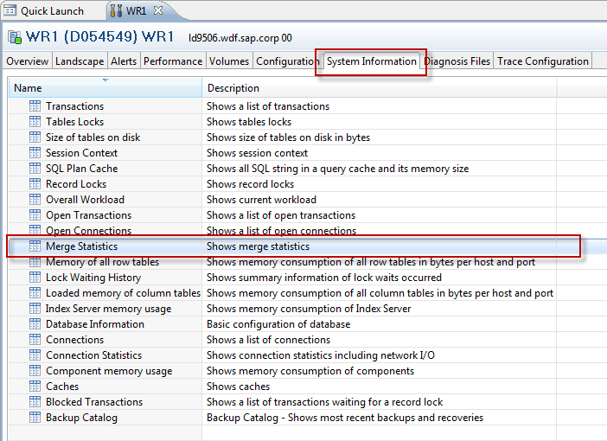
Merge History
All smart merges are logged and are found in the monitoring view M_DELTA_MERGE_STATISTICS.
There you can find several delta merge details like table name, merge start time, merge duration and so on.

Slide 15
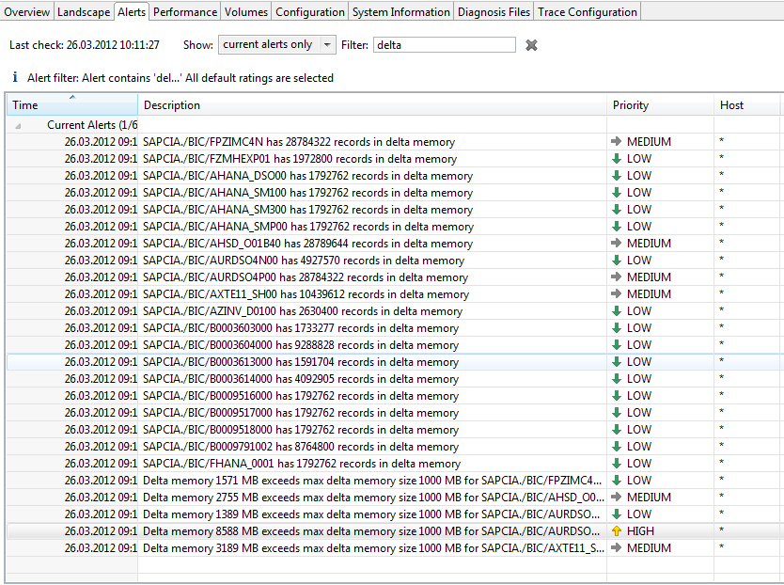
Alerts
There are certain alerts in SAP HANA related to the delta merge (e.g.: delta memory size, etc.).
The alerts are only visible via the SAP HANA studio. There are no SAP NetWeaver BW specific logs which can be viewed from within SAP NetWeaver BW.

Slide 16
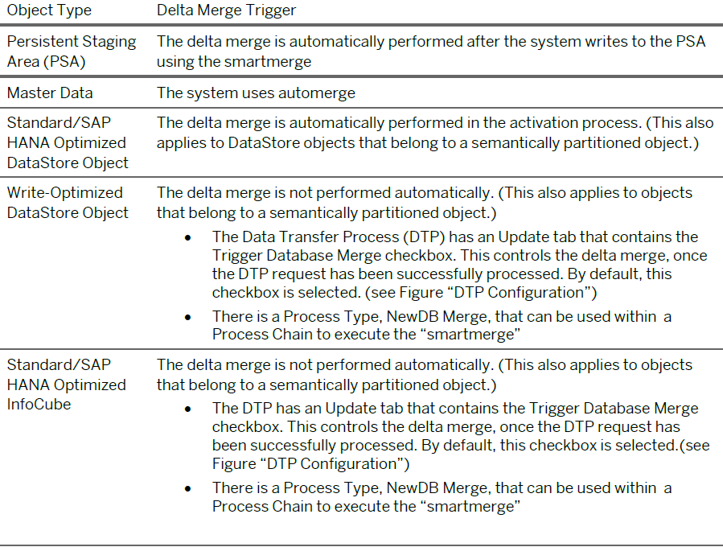
SAP NetWeaver BW Specifics

Slide 17
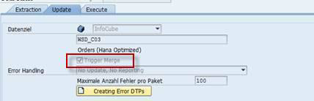
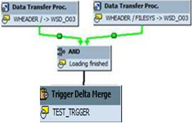
Keep in mind that the hard limit of 2 billion rows per partition also applies to the delta storage.
Additionally delta merge requires a certain amount of additional memory which might cause an out of memory problem if the delta storage is not merged from time to time and gets too large.
DTP Trigger Setting for Invoking “Smartmerge” Hint
Process Type to Trigger “Smartmerge” Hint
Make sure that a delta merge is triggered by either the DTP or the process type. Otherwise the data remains in the delta storage table and over time this leads to suboptimal memory use and read performance. It can also lead to data loss or corruption.

Slide 18
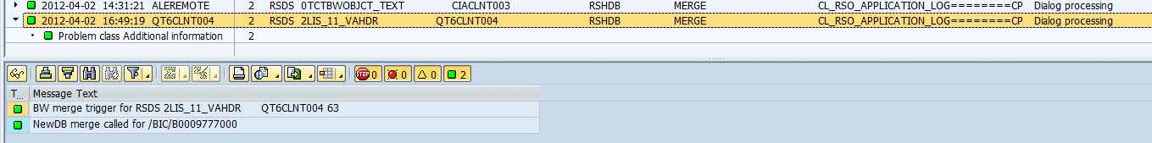
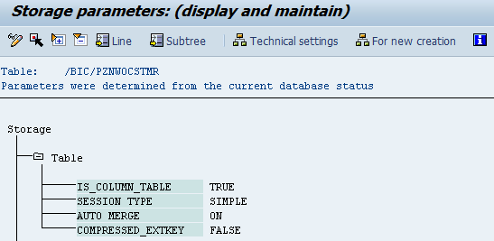
BW Application Log entries for Delta Merge Trigger
If a smartmerge HINT is triggered from BW, an entry is created in the application log. Use transaction SLG1 to view the application logs.
Review Automerge Setting by Table
The automerge setting assigned to any BW table can be viewed in the SAP NetWeaver BW application via the following path:
Tcode SE11 -> Utilities -> Database Object -> Database Utility -> Storage Parameters (button)

Slide 19
THANK YOU

